Slide 1
Lecture 11
Chapter 7
Input/Output

Slide 2
Interrupt-Driven I/O
Overcomes CPU waiting
No repeated CPU checking of device
I/O module interrupts when ready

Slide 3
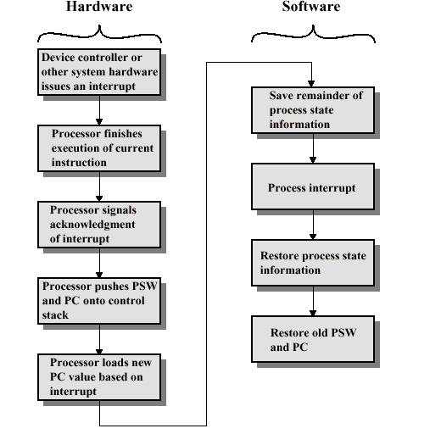
Simple Interrupt Processing

Slide 4
Interrupt Driven I/O
Basic Operation
CPU issues read command to I/O module
I/O module gets data from peripheral while CPU does other work
When data are in the I/O module’s data register, the module interrupts CPU
CPU requests data
I/O module transfers data

Slide 5
CPU Viewpoint
Issue read command
Do other work (e.g. processor may be working on several different programs)
Check for interrupt at end of each instruction cycle
If interrupted:-
  Save context (program counter, processor registers)
  Process interrupt
    Fetch data from I/O module & store in memory
Processor then restores the context of the program it was working on and resumes execution.

Slide 6
Design Issues
How do you identify the module issuing the interrupt?
How do you deal with multiple interrupts?
  i.e. an interrupt handler being interrupted

Slide 7
Identifying Interrupting Module (1)
Different line for each module
  PC
  Limits number of devices
Software poll
  CPU asks each module in turn
  Slow

Slide 8
Identifying Interrupting Module (2)
Daisy Chain or Hardware poll
  Interrupt Acknowledge sent down a chain
  Module responsible places vector on bus
  CPU uses vector to identify handler routine
Bus Master
  Module must claim the bus before it can raise interrupt
  e.g. PCI & SCSI

Slide 9
Multiple Interrupts
Each interrupt line has a priority
Higher priority lines can interrupt lower priority lines
If bus mastering only current master can interrupt

Slide 10
Example - PC Bus
80x86 has one interrupt line
8086 based systems use one 8259A interrupt controller
8259A has 8 interrupt lines

Slide 11
Sequence of Events
8259A accepts interrupts
8259A determines priority
8259A signals 8086 (raises INTR line)
CPU Acknowledges
8259A puts correct vector on data bus
CPU processes interrupt

Slide 12
PC Interrupt Layout
8259A
8086
IRQ0
IRQ1
CPU
IRQ2
IRQ3
INTR
IRQ4
IRQ5
IRQ6
IRQ7
I/O Module

Slide 13
ISA Bus Interrupt System
ISA bus chains two 8259As together
Link is via interrupt 2
Gives 15 lines
  16 lines less one for link
IRQ 9 is used to re-route anything trying to use IRQ 2
  Backwards compatibility
Incorporated in chip set

Slide 14
ISA Interrupt Layout
(IRQ 2)
8259A
8259A
80x86
IRQ0 (8)
IRQ0
IRQ1 (9)
IRQ1
IRQ2 (10)
IRQ2
IRQ3 (11)
IRQ3
INTR
IRQ4 (12)
IRQ4
IRQ5 (13)
IRQ5
IRQ6 (14)
IRQ6
IRQ7 (15)
IRQ7

Slide 15
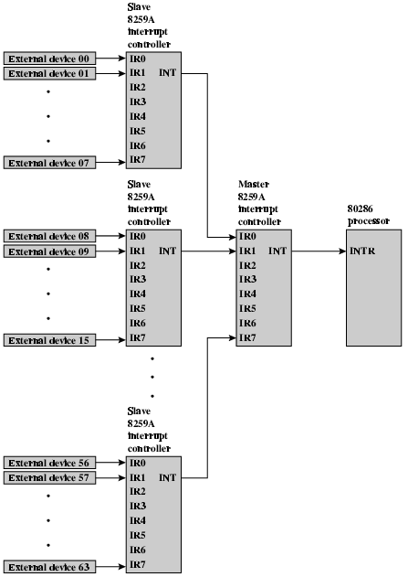
82C59A Interrupt
Controller

Slide 16
82C55A Programmable Peripheral Interface

Slide 17
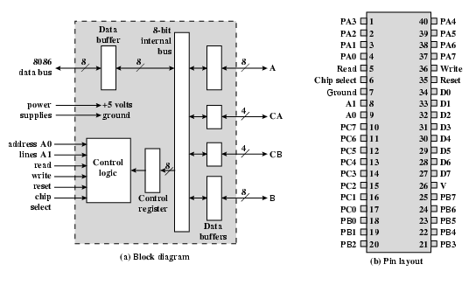
Intel 82C55A
Programmable Peripheral Interface

Slide 18
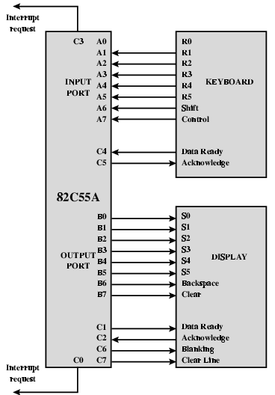
Using 82C55A To Control Keyboard/Display

Slide 19
Direct Memory Access
Interrupt driven and programmed I/O require active CPU intervention
  Transfer rate is limited
  CPU is tied up
Consider the case of moving a block of data
  Using programmed I/O, the CPU is dedicated to the task of I/O and can move data at a higher rate, at the cost of doing nothing
  Using interrupt I/O, free up to some extent at the expense of the I/O transfer rate
  Both methods have adverse impact on both CPU activity and I/O transfer rate
DMA is the answer

Slide 20
DMA Function
Additional Module (hardware) on system bus, as show in the next figure
DMA controller takes over from CPU for I/O
DMA module must use the bus only when the processor does not need it, or it must force the processor to suspend operation temporarily.
The last technique (above, in blue) is more common and is named as cycle stealing

Slide 21
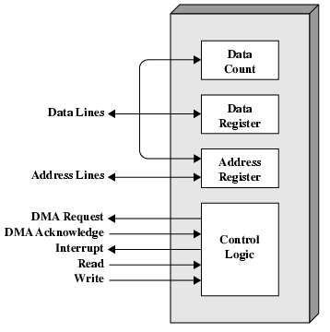
DMA Module Diagram

Slide 22
DMA Operation
CPU tells DMA controller:
  Read/Write
  Device address
  Starting address of memory block for data
  Amount of data to be transferred
CPU carries on with other work
DMA module deals with transfer (one word at a time), directly to or from memory, without going through the processor
DMA controller sends interrupt to the processor when finished
Thus, the processor is involved only twice, at the beginning and end of the transfer

Slide 23
DMA Transfer Cycle Stealing
DMA controller takes over bus for a cycle
Transfer of one word of data, at a time
Not an interrupt
  CPU does not switch context
CPU suspended just before it accesses bus
  i.e. before an operand or data fetch or a data write
Slows down CPU but not as much as CPU doing transfer, such as in Programmed I/O and Interrupt I/O

Slide 24
Aside
What effect does caching memory have on DMA?
Hint: how much are the system buses available?

Slide 25
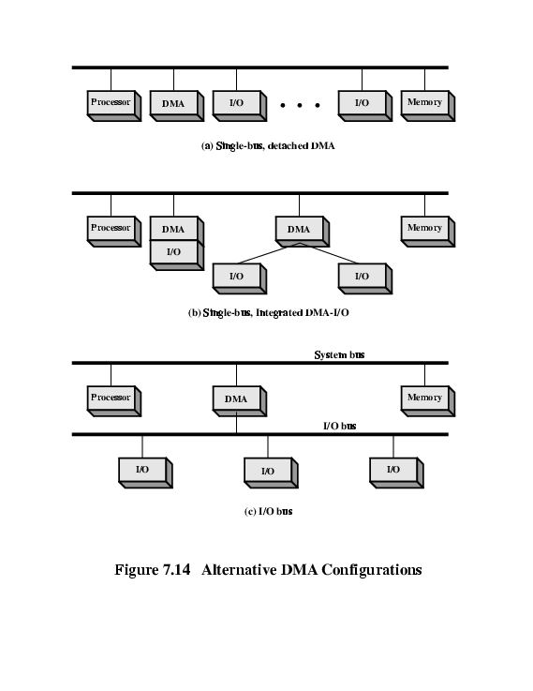
DMA Configurations (1)
Single Bus, Detached DMA controller
Each transfer uses bus twice
  I/O to DMA then DMA to memory
CPU is suspended twice (each transfer of a word consumes two bus cycles)
This configuration seems to be inexpensive, it is clearly inefficient

Slide 26
DMA Configurations (2)
— One or more I/O modules NOT included in the system bus
Single Bus, Integrated DMA controller. Thus, required bus cycles are much fewer
Controller may support >1 device
Each transfer uses bus once
  DMA to memory
CPU is suspended once

Slide 27
DMA Configurations (3)
Separate I/O Bus
Bus supports all DMA enabled devices
Each transfer uses bus once
  DMA to memory
CPU is suspended once

Slide 28
I/O Channels
I/O devices getting more sophisticated
Ability to execute I/O instructions. Thus, complete control over I/O operation
e.g. 3D graphics cards
CPU instructs I/O controller to do transfer
I/O controller does entire transfer
Improves speed
  Takes load off CPU
  Dedicated processor is faster

Slide 29
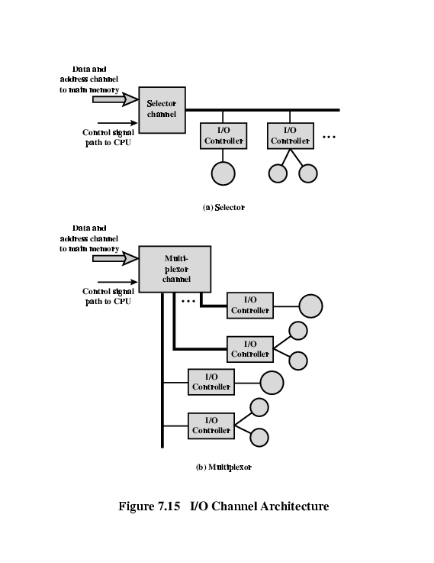
I/O Channel Architecture
Selector Channel
Multiplexor Channel

Slide 30
I/O Channel Architecture
Selector Channel
Controls multiple high speed devices
Any given time, it is dedicated to the transfer of data with one of those devices
Thus, I/O channel selects one device and effects the data transfer
Multiplexor Channel
Handle I/O with multiple devices at the same time
Low speed devices: a byte multiplexor accepts or transmits characters as fast as possible to multiple devices. E.g.,
A1A2A3A4,B1B2B3B4 and C1C2C3C4 can be A1B1C1A2C2A3B2C3A4
High speed devices, a block multiplexor interleaves blocks of data from several devices

Slide 31
Interfacing
Connecting devices together
Bit of wire?
Dedicated processor/memory/buses?
E.g. FireWire, InfiniBand

Slide 32
IEEE 1394 FireWire
High performance serial bus
Fast
Low cost
Easy to implement
Also being used in digital cameras, VCRs and TV

Slide 33
FireWire Configuration
Daisy chain
Up to 63 devices on single port
  Really 64 of which one is the interface itself
Up to 1022 buses can be connected with bridges
Automatic configuration
No bus terminators
May be tree structure

Slide 34
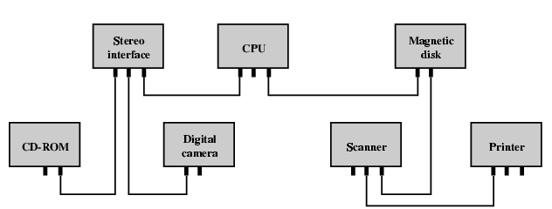
Simple FireWire Configuration

Slide 35
FireWire 3 Layer Stack
Physical
  Transmission medium, electrical and signaling characteristics
Link
  Transmission of data in packets
Transaction
  Request-response protocol

Slide 36
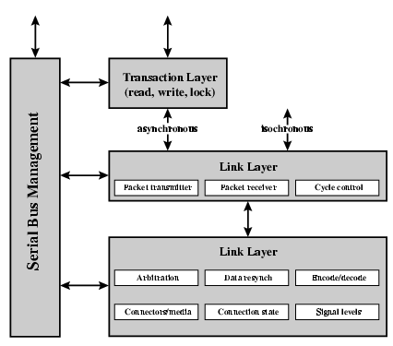
FireWire Protocol Stack

Slide 37
FireWire - Physical Layer
Data rates from 25 to 400Mbps
Two forms of arbitration
  Based on tree structure
  Root acts as arbiter
  First come first served
  Natural priority controls simultaneous requests
    i.e. who is nearest to root
  Fair arbitration
  Urgent arbitration

Slide 38
FireWire - Link Layer
Two transmission types
  Asynchronous
    Variable amount of data and several bytes of transaction data transferred as a packet
    To explicit address
    Acknowledgement returned
  Isochronous
    Variable amount of data in sequence of fixed size packets at regular intervals
    Simplified addressing
    No acknowledgement

Slide 39
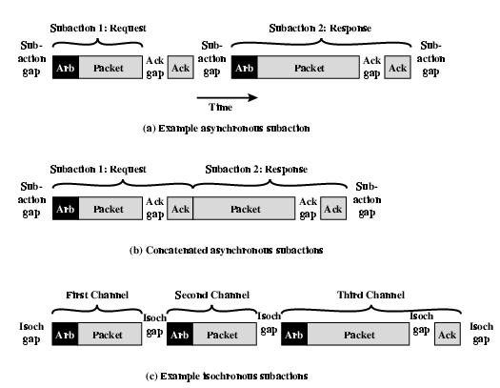
FireWire Subactions

Slide 40
InfiniBand
I/O specification aimed at high end servers
  Merger of Future I/O (Cisco, HP, Compaq, IBM) and Next Generation I/O (Intel)
Version 1 released early 2001
Architecture and spec. for data flow between processor and intelligent I/O devices
Intended to replace PCI in servers
Increased capacity, expandability, flexibility

Slide 41
InfiniBand Architecture
Remote storage, networking and connection between servers
Attach servers, remote storage, network devices to central fabric of switches and links
Greater server density
Scalable data centre
Independent nodes added as required
I/O distance from server up to
  17m using copper
  300m multimode fibre optic
  10km single mode fibre
Up to 30Gbps

Slide 42
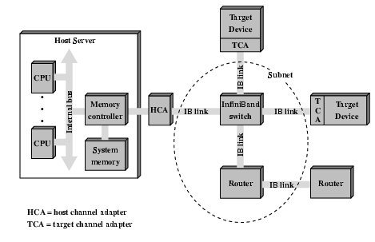
InfiniBand Switch Fabric

Slide 43
InfiniBand Operation
16 logical channels (virtual lanes) per physical link
One lane for management, rest for data
Data in stream of packets
Virtual lane dedicated temporarily to end to end transfer
Switch maps traffic from incoming to outgoing lane

Slide 44
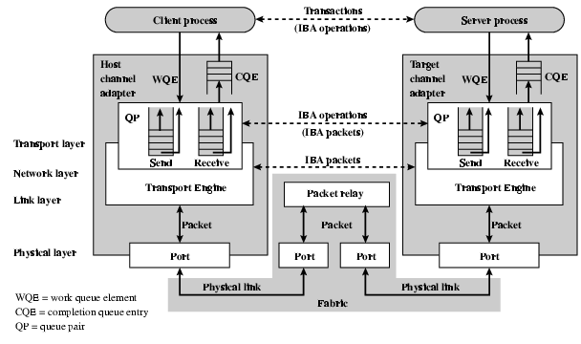
InfiniBand Protocol Stack

Slide 45
Foreground Reading
Check out Universal Serial Bus (USB)
Compare with other communication standards e.g. Ethernet

